Slide 1
Working Group Meeting
February 29, 2016
888-844-9904 passcode 2590235#

Slide 2
Outline
Introductions
Recent accomplishment highlights
5-Year Plan for USDA-ARS
Charge Questions
Executive Session (WG-only)
Summary from WG to MaizeGDB Team

Slide 3
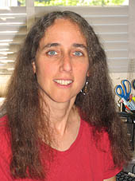
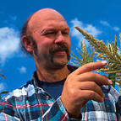
Working Group
Evaluate MaizeGDB’s current status and recommend strategic courses of action that ensure that MaizeGDB activities are on-target
Meet on an annual or as-needed basis
Alice Barkan Qunfeng Dong Dave Jackson Thomas Lubberstedt
Eric Lyons Adam Phillippy (chair) Marty Sachs Mark Settles Nathan Springer

Slide 4
Core employees, 5.75 FTEs, (funding)
Carson Andorf, 1FTE
Computational biologist, lead scientist (USDA)
Lisa Harper, 0.5FTE Curator & outreach in Albany, CA, (USDA)
John Portwood, 1FTE computer programmer and database administrator, (USDA)
Mary Schaeffer, 1FTE Curator, Columbia, MO, (USDA)
Taner Sen, 1FTE computational biologist (USDA)
Ethy Cannon, 0.5FTE bioinformatics engineer (Iowa State)
Jack Gardiner, 0.25FTE curator in Columbia, MO, (Iowa State)
Bremen Braun, 0.5FTE
Scientific programmer in Minneapolis (ORISE)
4

Slide 5
Iowa State Students
Graduate
Kyoung Tak Cho, Ph.D.
Nancy Manchaanda, Ph.D.
Undergraduate:
Michael Brumfield, interface developer
Brittney Dunfee, curator
Ashley Enger, graphic and multimedia designer
David Schott, interface developer

Slide 6
Vacant positions
Currently vacant:
IT-Specialist, full-time permanent (Vice- Andorf)
IT-Specialist, full-time permanent (Vice-Campbell)
In-progress:
Postdoctoral fellow
Anticipated:
Scientist, computational biologist, full-time permanent (Vice-Sen)
Scientist, curator, full-time permanent (Vice-Schaeffer)
Net gain of up to 3 FTEs

Slide 7
Accomplishment Highlights

Slide 8
MaizeGDB update and expansion
Develop and deploy a modern interface
Reorganize and provide hierarchy to existing data
Incorporate new data types (including diversity data, expression data, gene models, and metabolic pathways)
Update the genome browser
Upgrade hardware and infrastructure

Slide 9
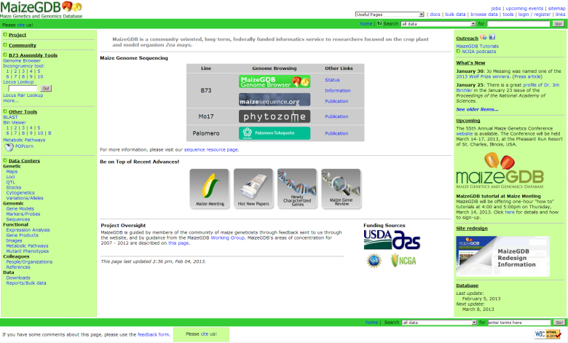
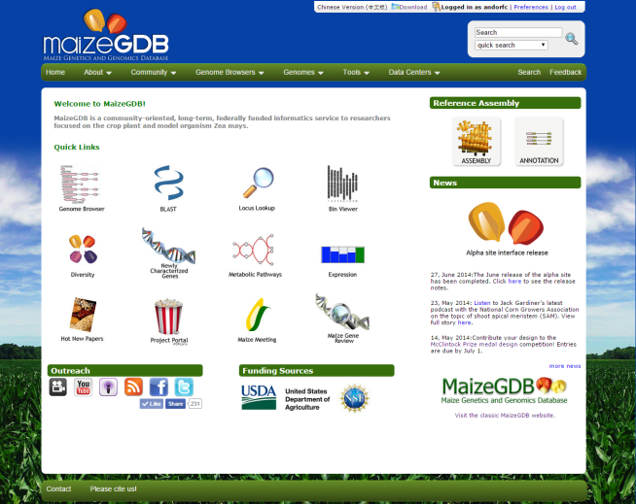
MaizeGDB Evolution
2002
2016
2015
Notes:
9

Slide 10
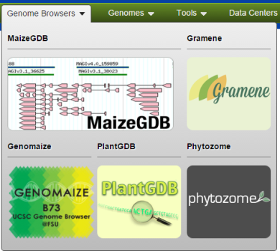
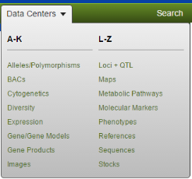
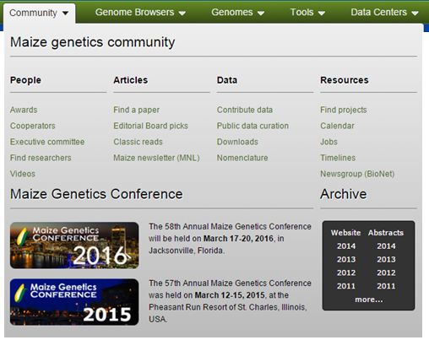

Slide 11
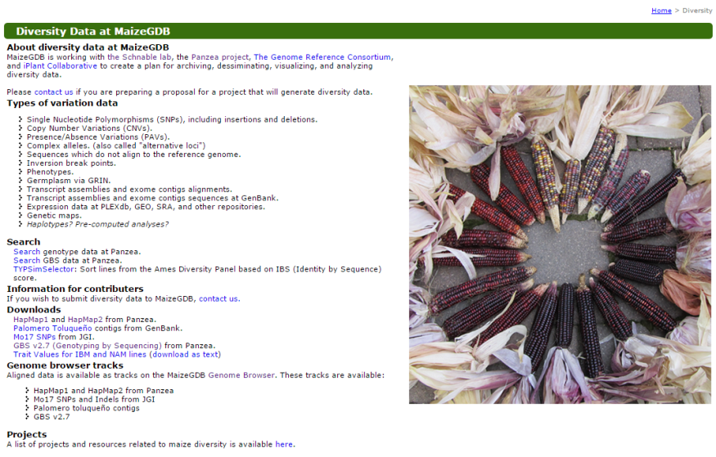
Diversity Page

Slide 12
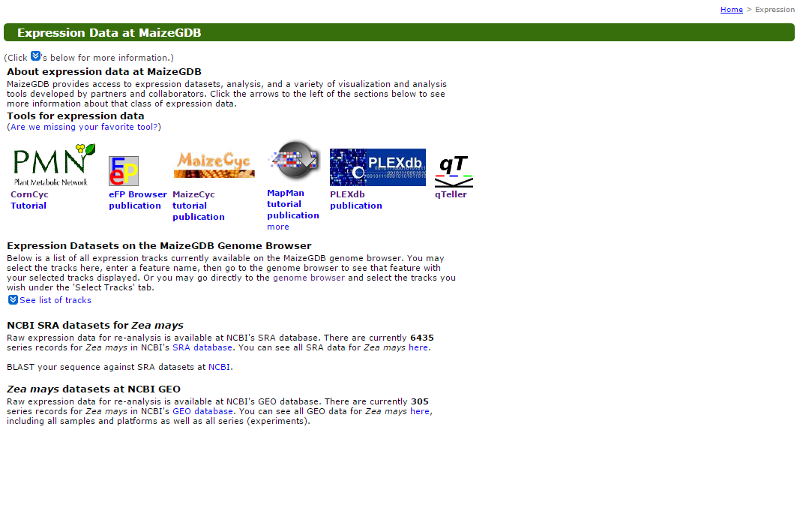
Expression Page

Slide 13
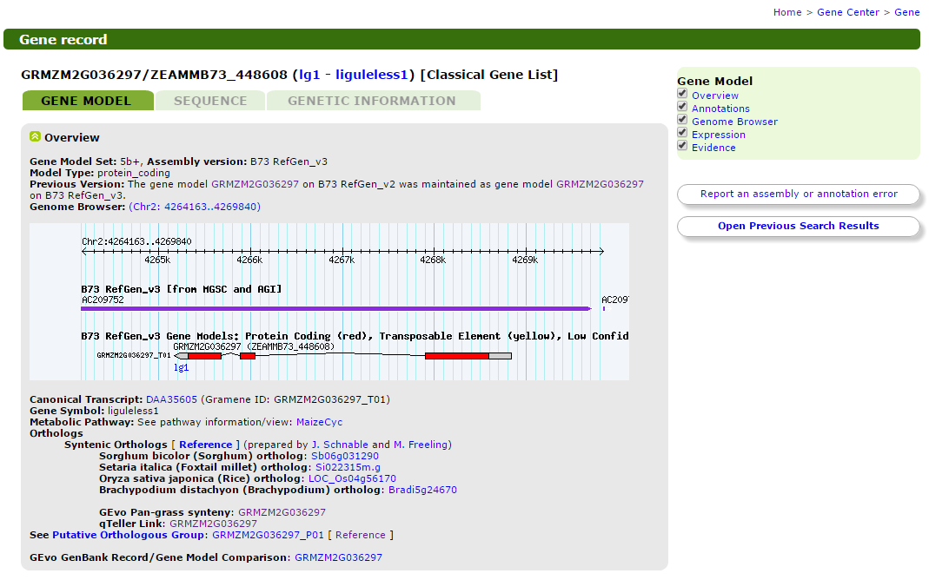
Gene Model Page

Slide 14
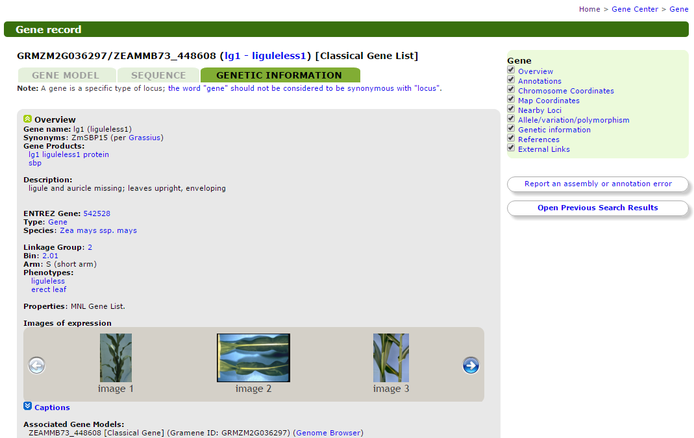
Gene Model Page
Page

Slide 15
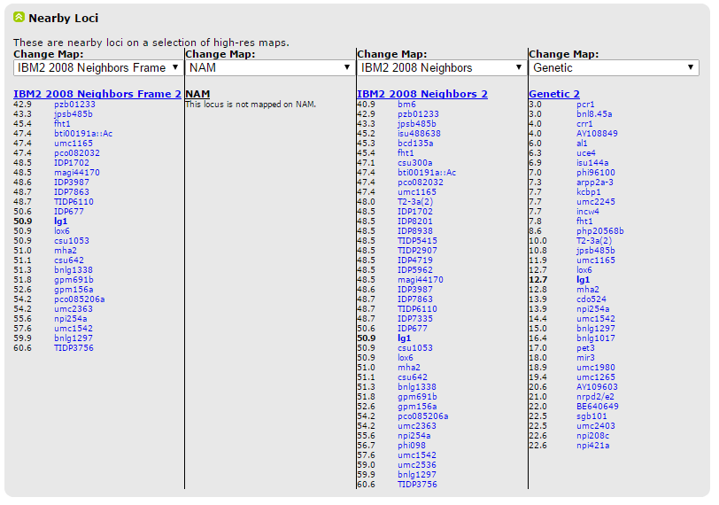
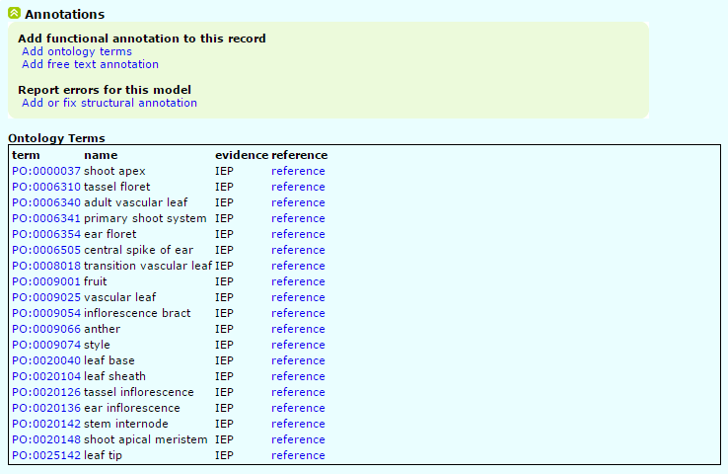
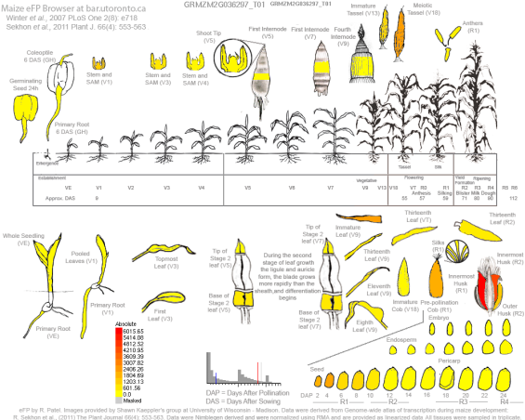
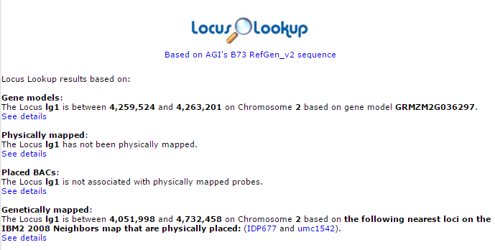

Slide 16
Genome Browser Tracks (v2)
Assembly/Genome Features
Pseudomolecule
anti-CENH3 ChIP
Bins
Centromere
FPC Contig
Gaps
GSS_PlantGDB
NOL Nucleosome Occupancy Likelihood
Annotations Reconstructed Chromosomes from the Maize Tetraploidy
Diversity
HapMap1
HapMap2
Mo17 SNPs and Indels (JGI)
Mo17 SNPs and Indels (XIN 2013)
ISU SNPs
Palomero Toluqueño contigs
Illumina MaizeSNP50 BeadChip
Protein Atlas
Non-modified peptides identified in B73 seed development
Phosphorylated Peptides identified in B73 seed development
Gene Models
B73 RefGen_v2 Gene Models
B73 RefGen_v2 Gene Models: Quality
MAGI
ZmGDB yrgate Community Annotations
Chloroplast genes
Mitochondrial genes
Sorghum-B73 Syntenic Genes
Split Genes
G4 Tracks
All maize motifs
Patches
Genomic Features
Gene-related Grouping
Repetitive Elements
MIPS_Repeats
Sirevirus retrotransposons
Expression and Transcripts
Affymetrix Maize100WT Source Sequence
Affymetrix Maize100WT Probes
Affymetrix Maize100WT Probe Sets
cDNA
ESTs
Fluorescent protein tags
Genome-wide Expression Atlas
Genome-wide Expression Atlas Coefficient of Variation by Probe
Genome-wide Atlas Maximum Mean Normalized Expression
Genome-wide Atlas Expression Across Tissues by Probe
KNOTTED1 Binding Regions
Microarray Agilent 4x44K maize microarray probes
Microarray Probes at PLEXdb
miRNA
PlantGDB Unique Transcripts (PUTs)
RNA-Seq based Expression Atlas in B73
SAM: Shoot Apical Meristem at Six Stages
IBM SAM RIL Data
Genetic Map
Genetically Mapped Illumina MaizeSNP50
IBM2009 ISU Integrated Markers
Segments of Known Genetic Distance
Insertions
Ac/Ds
Ac/Ds from the Dooner Lab
Heritable Mu Insertions
UniformMU
MaizeGDB Custom Tracks
BLAST Hits
Locus Lookup

Slide 17
Genome Browser Tracks (v3)
New Genome Browser B73 RefGen_v3 Tracks:
MAKER-P Gene Models
HapMapV3
NCBI Annotation Release 100
G4 Quadruplex Motifs (4 tracks)
RNA-Seq Expression Atlas
(Private – waiting on publication) Phosphorylated Peptides from 33 Tissues
(Private – waiting on publication) Non-modified Peptides from 33 Tissues
Pan-genome Sequence Anchors
Bins
Mo17 SNPs and Indels
Fluorescent protein tags
GBS v2.7 diversity data
De novo transcript assemblies from JGI
Non-modified and Phosphorylated peptides
TSS transcription initiation sites, experimental, CAGE ( “CAP analysis of gene expression”) (in progress)
Projected 25 tracks from v2 to v3 based on coordinate positions.

Slide 18
MaizeGDB 5-Year Project Plan

Slide 19
Timing of ARS review process for current CRIS
National Program 301
Plant Genetic Resources, Genomics and Genetic Improvement
Accomplishment report, 2006-2011
Assessment, (last 5 years)
Stakeholders meeting: November 15, 2011
Scientists meeting: March 16, 2012
New Action Plan: March 29, 2012
Concept paper due: May 17, 2012
Project Plan due to the ARS Office of Scientific Quality Review:
January 3, 2013 [ARS external review process]
Project start date: May 2013
Project end date: May 2018

Slide 20
5-Year Project Plan, 2013-2018
Objective 1: Support stewardship of maize genome sequences and forthcoming diverse maize sequences.
Objective 2: Create tools to enhance access to expanded datasets that reveal gene function and datasets for genetic and breeding analyses.
Objective 3: Deploy tools to increase user-specified flexible queries
Objective 4: Provide community support services, training and documentation, meeting coordination, and support for community elections and surveys.
Objective 5: Facilitate the use of genomic and genetic data, information, and tools for germplasm improvement, thus empowering ARS scientists and partners to use a new generation of computational tools and resources.

Slide 21
Objective 1: Support stewardship of maize genome sequences and forthcoming diverse maize sequences.

Slide 22
Stewardship of the B73 Reference Genome
Work closely with Gramene, GenBank, and the Genome Reference Consortium (GRC).
Provide genome browsers, gene model information, BLAST capability.
Prepare for release of v4 (release is in March, 2016).
Preserve older versions of the assembly, including the BAC-based assembly.

Slide 23
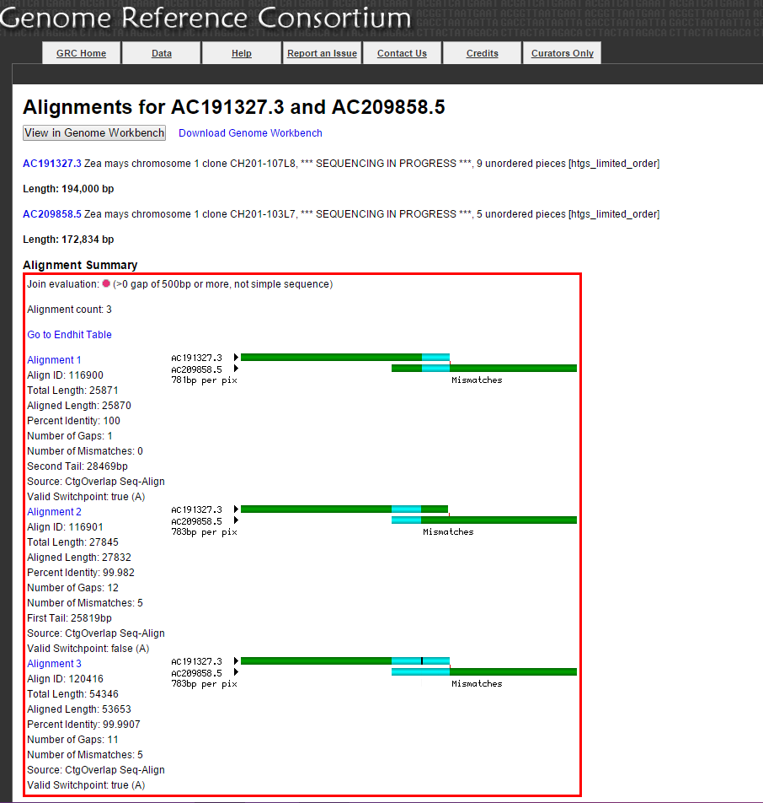
The GRC provides pipelines and tools for improving reference genomes.

Slide 24
B73 Reference Genome error management
Researchers can report assembly and gene model issues on several pages on the website or through personal e-mails.
Database of assembly and gene model issues has been established at MaizeGDB (547 issues as of Feb, 2016)
Issues will be assessed, reported, and if possible, resolved using the GRC tools by an assembly curator at MaizeGDB.

Slide 25
Maize Diversity – additional genomes
Working closely with W22, B104, and CML247 genomes.
Collecting metadata about each genome based on the plant extension to MIxS (Minimum Information about any(x) Sequence).
Helping submit genomes and structural annotation to GenBank.
Template will be available for use by other sequencing projects.
Working with CyVerse, which is developing a pipeline for genome submission.
For each genome MaizeGDB will provide:
pages listing metadata (MIxS & GenBank) for each genome and annotation.
browsers
BLAST
gene model pages

Slide 26
W22 Genome Browser (currently private)

Slide 27
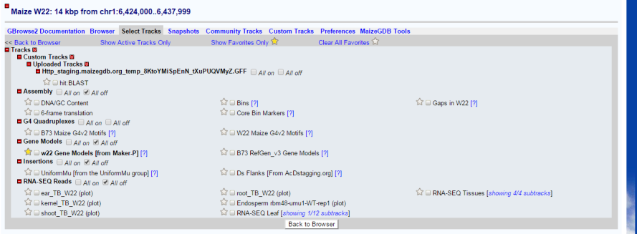
New Genomes’ Tracks
New W22 Tracks (all currently private - waiting on publication):
DNA/GC Content, from W22 Group (assembly statistics)
6-frame translation, from W22 Group (assembly statistics)
Bins, (Andorf)
Core Bin Markers, (Andorf)
Gaps, W22 Group (assembly statistics)
B73 Maize G4v2 Motifs, (Andorf)
W22 Maize G4v2 Motifs, (Bass and Andorf)
W22 MAKER-P Gene Models, from W22 Group
B73 RefGen_v3 Gene Models, (Wimalanathan and Vollbrecht)
UniformMu Insertions, UniformMu group (McCarty and Koch)
Ds Flanks, (AcDstagging.org)
RNA-Seq reads: ear, kernel, shoot, root, endosperm, leaf, from W22 Group
New B104 Tracks (private):
B104 Assembly, from B104 Group (Wang, Lawrence-Dill, Andorf)
B104 MAKER-P Gene Models
B73 RefGen_v3 Gene Models
New CML247 Tracks (private):
CML247 MAKER-P Gene Models, CML247 Group (Buckler)
B73 RefGen_v3 Gene Models, CML247 Group (Buckler)

Slide 28
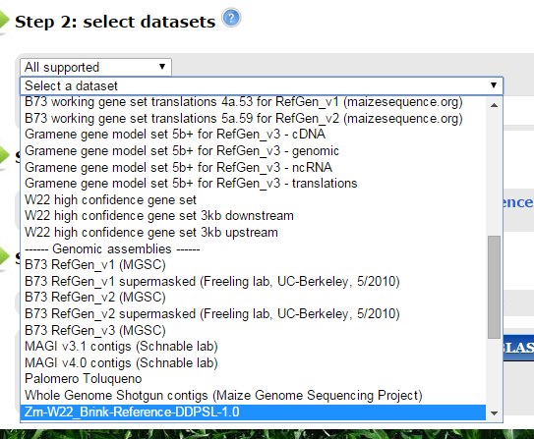
W22 BLAST Targets

Slide 29
Objective 2: Create tools to enhance access to expanded datasets that reveal gene function and datasets for genetic and breeding analyses.

Slide 30
Metabolic Networks
We are continuing our collaboration with Plant Metabolic Network to maintain and create new version of CornCyc, i.e., maize metabolic network.

Slide 31
Breeder Resources to Visualize Diversity and Pedigree Relationships - Survey Results
Highest priority visualization needs
SNPs in a region for a given list of lines
Pedigree relationships
Haplotype analysis in a given list of lines
Highest priority populations
3000 inbred lines from the paper of Romay et al. (Genome Biol, 14:R55, 2013)
Expired PVP lines (Plant Variety Protection Act)

Slide 32
Ongoing Projects resulting from the Survey
Pedigree relationships
Displaying immediate progenies of current stocks at the MaizeGDB Stock pages
Curating most recent ex-PVP lines in GRIN into the maize database and their display on the MaizeGDB Stock page
Developing network views of pedigree relationships (Pedigree Viewer)
SNPs in a region for a given list of lines (Genotype Visualization tool)
Visualizing genotypes such as SNPs from diversity lines
Developing user friendly tools for SNP queries

Slide 33
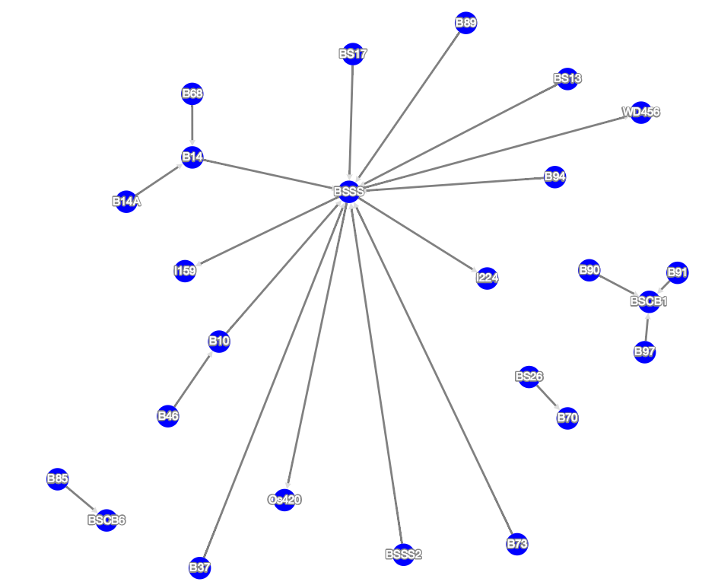
Pedigree Viewer
Displays pedigree relationships between 4,705 maize lines available on the MaizeGDB Stock Pages, using a network representation.

Slide 34
Genotype Visualization Tool
The tool contains GBS data from Panzea’s ZeaGBSv2.7, raw and imputed, for 955,690 SNPs in 17,280 lines.

Slide 35
Objective 3: Deploy tools to increase user-specified flexible queries.

Slide 36
Providing custom datasets
MaizeGDB users need a flexible way to retrieve up to date, bulk data sets directly from the MaizeGDB database
InterMine (MaizeMine) is an open source data warehouse application selected to address MaizeGDB users requests for bulk data.
Allows easy integration of complex biological datatypes
Facilitates customized, user-driven queries
Data model allows easy integration of new datatypes
Allows integration with analysis tools

Slide 37
Implementation of MaizeMine
Identify and select software to allow bulk data to be retrieved from MaizeGDB (Completed).
Release first version of MaizeMine at MaizeGDB website.
Develop a library of custom queries by soliciting input from MaizeGDB cooperators.
Revise and develop new queries and incorporate new datasets based on feedback.

Slide 38
Objective 4: Provide community support services, training and documentation, meeting coordination, and support for community elections and surveys.

Slide 39
Activities
Training workshops at least 2x per year
MGEC elections annually
Surveys in collaboration with MGEC at least 1x every 2 years
Maize meeting website, abstract submission, program preparation, and IT support annually
Ad hoc community support as needs arise
Maize Genetics Newsletter

Slide 40
Objective 5: Facilitate the use of genomic and genetic data, information, and tools for germplasm improvement, thus empowering ARS scientists and partners to use a new generation of computational tools and resources.

Slide 41
Activities
AgBioDatabase group: MaizeGDB initiated and leads a consortium of ~100 people from ~30 agriculturally related databases to identify common issues and work together on solutions.
Student training (10 students over 2 years)
Projects with student contributions include:
MaizeMine prototype
Diversity query tools
MaizeDig (Maize Database of Images and Genomes)
Literature curation and GO annotation
B73 Genome alignment analysis
Metabolic pathway data comparison
MaizeGDB interface development
Genome annotation and evaluation pipelines

Slide 42
WG Executive Closed Session
Goals:
Comment on past accomplishments
Address the charge questions, with an emphasis on long term community needs and strategic planning
Provide additional suggestions
Logistics
WG only stays on online and the phone
Let the MaizeGDB group know when to rejoin the conference call
Brief Verbal Feedback from WG to MaizeGDB Team (3:45pm CST)
Written Report from the Working Group by March 31, 2016

Slide 43
WG Executive Closed Session
Considerations:
With reduced staff and increased needs, we are asking more detailed charge questions.
The priorities you suggest will guide our hiring decisions.
We value your help in setting strategic priorities, as even fully staffed we may only be able to focus on a subset of the items listed.
We start planning for the next 5-year project plan next year, the WG-report will help guide this process.

Slide 44
Charge 1: Genome Assembly Stewardship
Should we devote curation effort into patch and new assembly releases for B73?
Utilizing GRC tools/pipeline requires skilled curation activity; should we redirect curation effort?
Should we continue to collect new assemblies and related metadata?
Should we integrate the data into MaizeGDB; eg, make gene models pages for every set of genes? Provide a genome browser? Provide a Cyc view?
What should MaizeGDB’s role be in encouraging researchers to submit genome assemblies to GenBank?
We are developing a metadata collection template to ease the submission. The template will be made freely available at MaizeGDB?
Should we map any data from B73 RefGen_v2/v3 to the v4 assembly?
B73 RefGen_v2 has 58 tracks of data. Twenty-six of those were computationally projected onto v3, while only 11 tracks were mapped directly to v3. Tracks are listed here http://www.maizegdb.org/gbrowse under the “select track” tab.

Slide 45
Charge 2: Big Data set identification, evaluation and incorporation
How do we triage Big Data sets reported in the literature?
This includes data sets that could be accessible by a genome browser, by MaizeMine, by special genotype-phenotype queries or other tools. Can you suggest new ways to evaluate large datasets? Ways to get community help to recommend data?
Our Project Plan Objective 2 is to incorporate experimentally confirmed functional genomic annotation including: GO annotation, phenotype/trait annotation, quantitative trait values, and Metabolic Pathway data.
This requires extensive manual literature curation. Can you suggest better, faster, less labor intensive ways to accomplish this objective? Possibilities include using the Editorial board, automated literature annotation, work with journals to get authors to submit pre-publication, develop and send templates to authors post-publication, and more.
How valuable is comprehensive integration of public QTL and GWAS data at MaizeGDB?
Currently we integrate into MaizeGDB a subset of available trait scores with metadata, but do not add researcher-identified QTL loci, either defined by a SNP or more loosely by a genetic region.

Slide 46
Charge 3: Tool Development
Should we improve existing tools to visualize and access large-scale diversity data (genotype, SNP and GBS data) such as haplotype viewers?
Should we transition to the JBrowse genome browser to handle larger datasets?
Should we improve query tools that use the hierarchical nature of ontologies with regard to phenotypes, mutants and genes?
For example, this tool would allow searches for mutant phenotype with parent term “leaf” to return phenotypes from all child terms (ligule, sheath, blade, margins, etc) as well as whole leaf phenotypes.
Should we update curation tools in collaboration with the Maize Genetics Stock Center? This would allow easier, faster manual literature curation and remove the complexity of having two different backend databases (Oracle and Postgres).
Should we find ways to better integrate information about Mu and AC tagged sequences into all areas of MaizeGDB?
For example, add available tagged alleles to gene model pages?

Slide 47
Charge 4: Future needs and expectations
Below is a list of expected needs in the next 5 years. Can you identify more, and can you comment on the importance of each of these?
Identifying and storing Genomes to Fields (G2F) type data (linking genotype and environment to phenotypes).
Finding a path to a pan genome infrastructure.
Using large-scale semi-automated literature curation, such as annotation by publisher and authors check as part of proof-reading pre-publication, etc
Multiple maize genomes comparison and display.

Slide 48
Thank you. Carson’s cell: (515)520-7412 carson.andorf@ars.usda.gov

