Slide 1
Maize Genetics Executive Committee
2013-2014 Report
Jeff Bennetzen, Chair

Slide 2
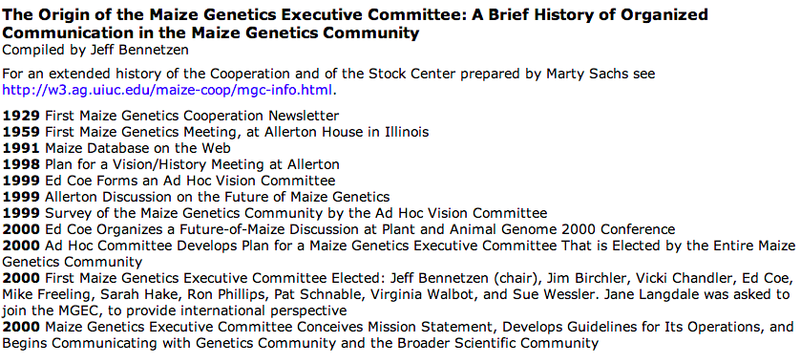
Origins of MGEC

Slide 3
Role of MGEC
…to identify both the needs and the opportunities for maize genetics, and to communicate this information to the broadest possible life science community.
This community includes scientists, funding sources for scientists, and the end users for the accomplishments of maize genetics, from farmers to consumers.
- Jeff Bennetzen, MNL 75

Slide 4
Elections and Membership
2013-2014
Elected (5 yr terms):
Jeff Bennetzen, 2013 (Chair) Rebecca Boston, 2013 Ed Buckler, 2014 Carolyn Lawrence, 2014 Marja Timmermans, 2015 Nathan Springer, 2015 James Birchler, 2016 Sarah Hake, 2016 Paul Chomet, 2017 Sherry Flint-Garcia, 2017
Appointed Positions (2 yr terms): Small college/university representative Brent Buckner (Truman State Univ), 2012 Latin American representative Ruairidh Sawers (Langebio-CINVESTAV), 2013 European representative Frank Hochholdinger (University of Bonn), 2012 Asian representative Jinsheng Lai (China Agricultural University), 2013
2014-2015
Elected (5 yr terms):
Ed Buckler, 2014 Carolyn Lawrence, 2014 Marja Timmermans, 2015 Nathan Springer, 2015 James Birchler, 2016 Sarah Hake, 2016 Paul Chomet, 2017 Sherry Flint-Garcia, 2017
Shawn Kaeppler, 2018
Pat Schnable, 2018
Appointed Positions: TBD

Slide 5
Accomplishments 2013-2014
2-Page Statement to Interagency Working Group on Plant Genomes
Founded the McClintock Prize
Surveyed the Community

Slide 6
Survey Results
Methods: your write-in suggestions matter
Top four research directions indicate a continued primary interest by this community in gene function, especially genome engineering
Enabling Genome Engineering: Support development and improvement of targeted genome engineering capacities (e.g., ZFN, TALENs, CRISPR/Cas).
Sequencing Genomes: Generate additional sequence for diverse maize genotypes and/or species closely related to maize
Enabling Genome Engineering: Simplify maize transformation.
Research Areas: Advance functional studies of maize genes, gene families, and networks
Community Resources: Stock Center indispensible, $50 fee unlikely to reduce use
Education:
Increase support for training in maize genetics, genomics, and bioinformatics.
Support diverse bioinformatics “workshops” at Maize Genetics Conferences and other locations.
http://maizemeeting.maizegdb.org/mgec-survey14/report2014.php

Slide 7
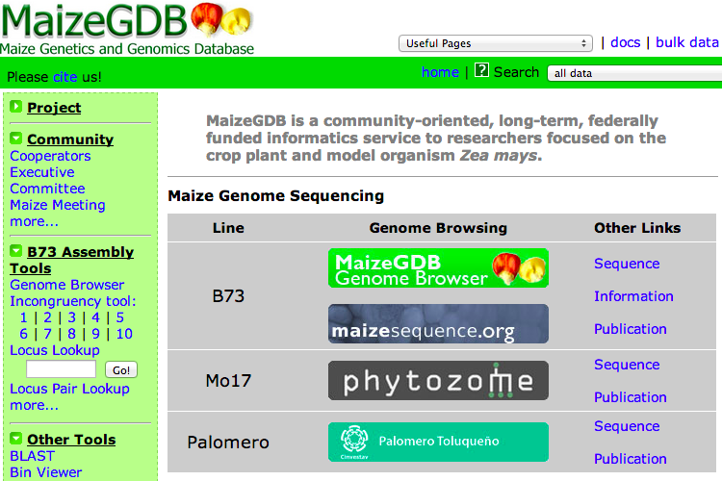
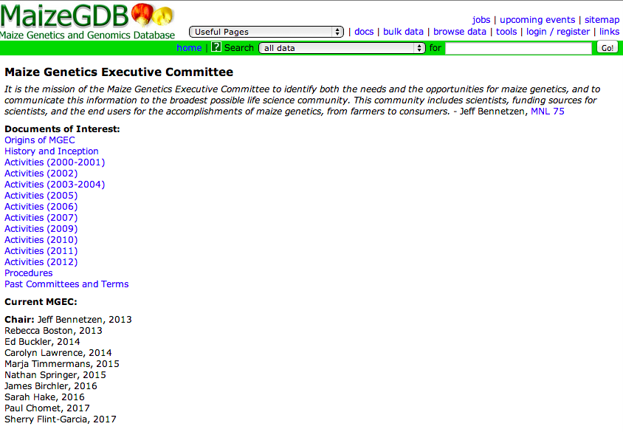
How to Contact MGEC

