Slide 2
Maize Genetics Community Session:
Update from US funding agencies:
-- Ann Sylvester, Program Director, PGRP
-- Cliff Weil, Rotator, PGRP
-- Karen Cone, Program Director, Genetic Mechanisms, MCB
Update from MaizeGDB:
-- Carson Andorf
Update from Maize Genetics Executive Committee (MGEC):
-- Karen Koch, Chair (UF) ----- Survey highlights and new initiatives
-- Jianming Yu, Chair-Elect (ISU)

Slide 3
Maize Genetics Community Session:
Update from US funding agencies:
-- Ann Sylvester, Program Director, PGRP
-- Cliff Weil, Rotator, PGRP
-- Karen Cone, Program Director, Genetic Mechanisms, MCB
Update from MaizeGDB:
-- Carson Andorf
Update from Maize Genetics Executive Committee (MGEC):
-- Karen Koch, Chair (UF) ----- Survey highlights and new initiatives
-- Jianming Yu, Chair-Elect (ISU)

Slide 4
Maize Genetics Community Session:
Update from US funding agencies:
-- Ann Sylvester, Program Director, PGRP
-- Cliff Weil, Rotator, PGRP
-- Karen Cone, Program Director, Genetic Mechanisms, MCB
Update from MaizeGDB:
-- Carson Andorf
Update from Maize Genetics Executive Committee (MGEC):
-- Karen Koch, Chair (UF) ----- Survey highlights and new initiatives
-- Jianming Yu, Chair-Elect (ISU)

Slide 5
The Maize Genetics Executive Committee (MGEC):
What do we do?
--- Identify needs and opportunities
--- Communicate to the broadest-possible life-science community
--- Help recognize some of the best among us (Awards)
--- Interface with MaizeGDB and the Steering Committee (Program)

Slide 6
The Maize Genetics Executive Committee (MGEC):
What do we do?
--- Identify needs and opportunities
--- Communicate to the broadest-possible life-science community
--- Help recognize some of the best among us (Awards)
--- Interface with MaizeGDB and the Steering Committee (Program)
New this year:
--- RA Emmerson Award for Lifetime Achievement in Maize Genetics
--- New funding and initiatives:
RCN (Research Coordination Network)
“Broadening and Energizing the Maize Genetics Research
Community”

Slide 7
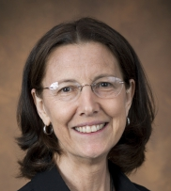
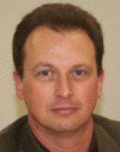
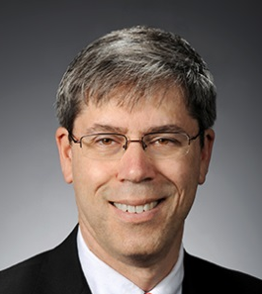
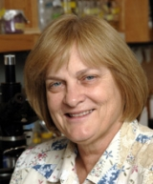
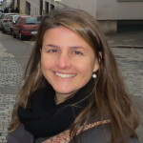
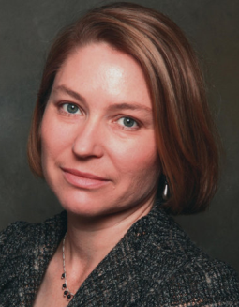
The Maize Genetics Executive Committee (MGEC)?
Karen Koch (Chair)
U. Florida
Jianming Yu (New Chair)
Iowa State U.
Sean Kaeppler
U Wisconsin
Paul Chomet
NRGene
Pat Schnable
Iowa State U
Kathleen Newton
Univ. Missouri
Natalia de Leon
U. Wisconsin
Sherry Flint-Garcia
USDA-ARS,U Missouri
Tom Brutnell
Danforth Center
David Jackson
Cold Spring Harbor Lab
Marilyn Wharburton
USDA
Ed Buckler
USDA, Cornell U.

Slide 8
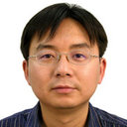
The Maize Genetics Executive Committee (MGEC) - Appointed members
Jianbing Yan
Huazhong Ag U
China
Asian Rep
Irina Makarevitch
Hamline U
USA
Small-Collage Rep
Silvio Salvi
U of Bologna
Italy
European Rep
Ruairidh Sawers
Cinvestav
Mexico
Latin American Rep

Slide 9
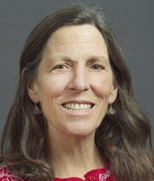
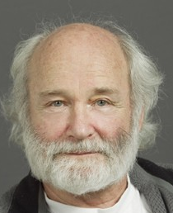
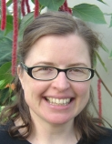
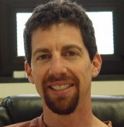
Awards Committee:
Nathan
Springer
U Minnesota
Sarah
Hake
UC Berkeley
Natalia
De Leon
UW-Madison
Mike
Freeling
UC Berkeley
Paula
McSteen
U Missouri
David
Braun
U Missouri
Jianming
Yu
Iowa State U

Slide 10
Maize Genetics Community?

Slide 11
Who are we?
Over 350 total replies – Thank you!

Slide 12
Who are we?
Over 350 total replies – Thank you!
Why does this matter?

Slide 13
Who are we?
Over 350 total replies – Thank you!
Why does this matter?
New funding: A Research Coordination Network (RCN) proposal
submitted by the Maize Genetics Executive Committee (MGEC) will be
funded by the US-National Science Foundation (NSF).

Slide 14
Who are we?
Over 350 total replies – Thank you!
Why does this matter?
New funding: A Research Coordination Network (RCN) proposal
submitted by the Maize Genetics Executive Committee (MGEC) will be
funded by the US-National Science Foundation (NSF).
Funding will support a 5-year plan for our community:
--- The next 5 Maize Genetics Conferences
--- Resources to help identify, prioritize, and target our most important
needs at a community level.

Slide 15
Who are we?
Over 350 total replies – Thank you!
Why does this matter?
New funding: A Research Coordination Network (RCN) proposal
submitted by the Maize Genetics Executive Committee (MGEC) will be
funded by the US-National Science Foundation (NSF).
Funding will support a 5-year plan for our community:
--- The next 5 Maize Genetics Conferences
--- Resources to help identify, prioritize, and target our most important
needs at a community level.
We need to know:
--- What ARE our most important needs at a community level?
--- How do we best increase our depth, breadth, and vibrancy?

Slide 16
The survey: Over 350 total replies – Thank you!

Slide 17
Who are we? Over 350 total replies – Thank you!
Sector
300
200
Replies (Number)
100
0
Academia
Public
Inst.
Private
Inst.
Gov.
Other

Slide 18
Who are we?
Role
200
Replies (Number)
100
0
Lab
Head
Research
Scientist
Grad
Student
Post
Doc
Educator
Other

Slide 19
Who are we?
Research areas
Cytogenetics
Crop evolution
Education, outreach
Transposons, epigenetics
Cell and developmental biol.
Computational and large-scale biol.
Quant genetics, breeding
Physiol, biochem, mol biol.
Other diverse areas
0 50 100 150 200 250
Replies (Number)

Slide 20
Who are we?
Diverse species studied
Arabidopsis
Sorghum
Rice
Soybean
Wheat
Setaria
Barley
Brassica
Brachypodium
Cotton
Tripsicum
Canola
+ Others
0 10 20 30 40 50 60
Replies (Number)

Slide 21
Who are we?
Number of Maize Genetics Conferences attended (lifetime)
50
40
30
Replies (Number)
20
10
0
0 5 10 15 20 25 30 35 40 45 50
MGC meetings attended (Number)

Slide 22
Community-level priorities?
Most important areas for community focus?
Genetic tools and resources
Informatic tools, resources, services
Training, student recruitment
Interface with private sector
Community breadth, expertise
0 1 2 3 4 5
Importance (5 high)

Slide 23
Community-level priorities?
Collective priorities
Genetic tools and resources
Informatic tools, resources, services
Training, student recruitment
Interface with private sector
Community breadth, expertise
0 1 2 3 4 5
Importance (5 high)

Slide 24
Community-level priorities?
Maize stock centers
Transformation and gene-editing facilities
Public knockout mutant resources
Collective priorities
0 1 2 3 4 5
Importance (5 high)

Slide 25
Community-level priorities?
Maize stock centers
Transformation and gene-editing facilities
Public knockout mutant resources
Collective priorities
Simplified access and retrieval from public databases
High-quality annotations for key inbreds
Improved tools for integration of omics data
0 1 2 3 4 5
Importance (5 high)

Slide 26
Community-level priorities?
Maize stock centers
Transformation and gene-editing facilities
Public knockout mutant resources
Collective priorities
Simplified access and retrieval from public databases
High-quality annotations for key inbreds
Improved tools for integration of omics data
$ for graduate students to attend maize meetings
0 1 2 3 4 5
Importance (5 high)

Slide 27
Community-level priorities?
Maize stock centers
Transformation and gene-editing facilities
Public knockout mutant resources
Collective priorities
Simplified access and retrieval from public databases
High-quality annotations for key inbreds
Improved tools for integration of omics data
$ for graduate students to attend maize meetings
Broaden participation in MAGNet-like programs
0 1 2 3 4 5
Importance (5 high)

Slide 28
Community-level priorities?
Maize stock centers
Transformation and gene-editing facilities
Public knockout mutant resources
Collective priorities
Simplified access and retrieval from public databases
High-quality annotations for key inbreds
Improved tools for integration of omics data
$ for graduate students to attend maize meetings
Broaden participation in MAGNet-like programs
Help support attendees from the developing world
0 1 2 3 4 5
Importance (5 high)

Slide 29
Community-level priorities?
Most important genetic tools and resources?
Maize stock centers
Transformation and gene-editing facilities
Public knockout mutant resources
Diversity, mapping, breeding populations
Field resources for multi-location testing, winter nurseries
Collections of transgenic marker lines for cell biol.
0 1 2 3 4 5
Importance (5 high)

Slide 30
Community-level priorities?
Most important informatic resources?
Simplified access and retrieval from public databases
High-quality annotations for key inbreds
Improved tools for integration of omics data
Integratable data sets for key inbreds
Coordination of multi-species data-sets for comparative genomics
Tools for acquisition and archiving of standardized phenotypic data
Tools for gene-to-cell system crop modeling and gene network analysis
Virtual reality resources for research and education
0 1 2 3 4 5
Importance (5 high)

Slide 31
Community-level priorities?
Most important training and recruitment goals?
$ for graduate students to attend maize meetings
Training workshops in emerging disciplines
Continuing education for mentors on informatics and quantitative bio
Resources to aid integration of bioinformatics in curricula
$ for undergraduates to attend maize meetings
0 1 2 3 4 5
Importance (5 high)

Slide 32
Community-level priorities?
Most important goals for basic to commercial?
Outreach to stakeholder groups
Workshops for entrepreneurship and tech transfer
0 1 2 3 4 5
Importance (5 high)

Slide 33
Community-level priorities?
Most important aspects of breadth?
Broaden participation in MAGNet-like programs
Strengthen integration with undergraduate institutions (PUIs)
Support speakers with expertise outside maize core
Recruit meeting attendees from outside the maize core
Send opt-in invitations to list-serves of other societies
Help support attendees from the developing world
0 1 2 3 4 5
Importance (5 high)

Slide 34
Community-level priorities?
Maize stock centers
Transformation and gene-editing facilities
Public knockout mutant resources
Collective priorities
Simplified access and retrieval from public databases
High-quality annotations for key inbreds
Improved tools for integration of omics data
$ for graduate students to attend maize meetings
Broaden participation in MAGNet-like programs
Help support attendees from the developing world
0 1 2 3 4 5
Importance (5 high)

Slide 35
Community-level priorities? – New initiatives
Most important areas for community focus?
Genetic tools and resources
Informatic tools, resources, services
Training, student recruitment
Interface with private sector
Community breadth, expertise
0 1 2 3 4 5
Focus groups in each area
-- for mid-year meeting
Importance (5 high)

Slide 36
The Maize Genetics Executive Committee (MGEC)?
Karen Koch (Chair)
U. Florida
Jianming Yu (New Chair)
Iowa State U.
Sean Kaeppler
U Wisconsin
Paul Chomet
NRGene
Pat Schnable
Iowa State U
Kathleen Newton
Univ. Missouri
Natalia de Leon
U. Wisconsin
Sherry Flint-Garcia
USDA-ARS,U Missouri
Tom Brutnell
Danforth Center
David Jackson
Cold Spring Harbor Lab
Marilyn Wharburton
USDA
Ed Buckler
USDA, Cornell U.

Slide 37
The Maize Genetics Executive Committee (MGEC) - Appointed members
Jianbing Yan
Huazhong Ag U
China
Asian Rep
Irina Makarevitch
Hamline U
USA
Small-Collage Rep
Silvio Salvi
U of Bologna
Italy
European Rep
Ruairidh Sawers
Cinvestav
Mexico
Latin American Rep

Slide 38
Community-level priorities? – New initiatives
Most important areas for community focus?
Genetic tools and resources
Informatic tools, resources, services
Training, student recruitment
Interface with private sector
Community breadth, expertise
0 1 2 3 4 5
Focus groups in each area
-- for mid-year meeting
Importance (5 high)

