Slide 1
Maize Community Session

Slide 2
Maize Genetics Executive Committee mission
It is the mission of the Maize Genetics Executive Committee to identify both the needs and the opportunities for maize genetics, and to communicate this information to the broadest possible life science community. This community includes scientists, funding sources for scientists, and the end users for the accomplishments of maize genetics, from farmers to consumers. - Jeff Bennetzen, MNL 75

Slide 3
MGEC membership
Elected Members:
James Birchler, 2016 - term complete
Sarah Hake, 2016 - term complete
Paul Chomet, 2017
Sherry Flint-Garcia, 2017
Shawn Kaeppler, 2018 (Chair)
Patrick Schnable, 2018
Kathy Newton, 2019
Jianming Yu, 2019 (incoming Vice-Chair)
Natalia de Leon, 2020
Karen Koch, 2020 (Vice-chair)
Tom Brutnell, 2021 - New
David Jackson, 2021 - New
Appointed Members
Latin America Rep: Ruairidh Sawers, 2016
Asia rep: Jianbing Yan, 2017
Small College/Univ. Rep: Evelyn Hiatt - term complete
Small College/Univ. Rep: Irina Makarevitch – 2020 -New
Europe Rep: Silvio Salvi, 2018

Slide 4
Maize Steering Committee Update

Slide 5


Bienvenue en France!
60th Maize Genetics Conference
March 22-25, 2018
Le Grand Large, Saint-Malo’s Convention Center

Slide 6
Maize Genetics Conference Steering Committee
Steering Committee 2017
Erich Grotewold, Chair
Alain Charcosset, co-Chair
David Braun – thank you!
Gernot Presting – thank you!
Petra Wolters – thank you!
Karen McGinnis
Jianbing Yan
Tom Slewinski
Sylvia de Sousa
Andrea Eveland
Maike Stam
Steering Committee 2018
Alain Charcosset, Chair
Mike Muszynski, co-Chair - welcome!
Erich Grotewold
Stephen Novak – welcome!
Andrea Gallavotti – welcome!
Karen McGinnis
Jianbing Yan
Tom Slewinski
Sylvia de Sousa
Andrea Eveland
Maike Stam
Paula McSteen, Treasurer – thank you!
David Braun, Treasurer - welcome!

Slide 7
MGEC activities
Awards
Facilitate interactions with federal agencies and NCGA
Community survey
Will develop RCN proposal to outline future priorities for the community and fund MGC and related activities

Slide 8
Funding Agency Updates
NSF
USDA
Success and Impact Stories are Critical for Agency Leaders to Educate Budget Decision-Makers
Regularly provide information to program officers of successes
Inform program officers when impactful manuscripts have been submitted and will be published so they have time to fully leverage their impact in DC

Slide 9

National Science Foundation
Karen Cone
Bill Eggleston
Anne Sylvester
Diane Jofuku Okamuro
Phil Becraft
Maize Genetics Conference, March 2017

Slide 10

Submissions to BIO Core Programs
Division of
Biological Infrastructure
(DBI)
Division of
Environmental Biology
(DEB)
Division of Integrative Organismal Systems
(IOS)
Division of Molecular and Cellular Biosciences
(MCB)
Check the NSF website for up-to-date information on solicitations, deadlines, and submission formats
Not sure which program is suitable for your research? Discuss your idea with a program officer to help identify the best fit.

Slide 11

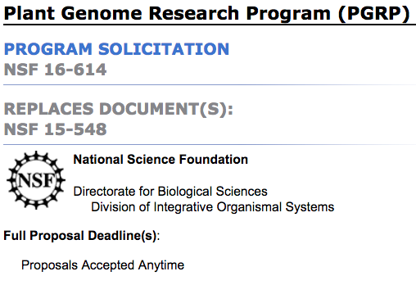
Plant Genome Research Program (PGRP)
For genome-scale research in economically important plants
Four focus areas
  RESEARCH: Basic research and/or tool development (revised)
  TRANSFORM Challenge grants: To improve plant transformation
  MINE Challenge grants: To mine and use existing datasets
  ECA or MCA: Early Career or Mid-Career awards (revised)
No Deadline: Proposals accepted any day, any time
  Solicitation at NSF 16-614 and FAQs at NSF 17-017
  Contact: dbipgr@nsf.gov
Notes:
Tools and resources still encouraged and emphasized!
New this year: two challenge grants; no deadline
FAQs available

Slide 12
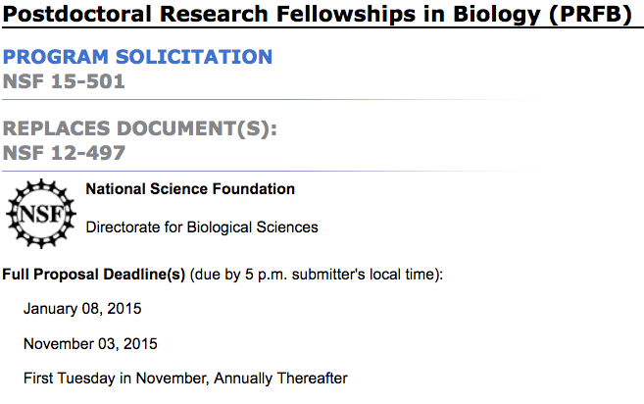
Postdoctoral Research Fellowships in Biology
Focus area #3: National Plant Genome Initiative
  Supported by the Plant Genome Research Program
  Genome-scale research in economically important plants with an “emphasis on quantitative genetics, modern breeding approaches, and bioinformatics.”
    Active mentoring and new training important
  Next Deadline: November 7, 2017
  Solicitation at NSF 15-501
  Contact: dbipgr@nsf.gov
Notes:
NPGI program: Joint NSF/DOE/USDA
Importance of expanding research training of Fellow
Funds go to fellow not sponsoring scientist
Stipend plus research budget
Funding rate 24%
6 page proposal

Slide 13
Grant Opportunities for Academic Liaison with Industry (GOALI)
Promotes collaboration between academic institutions and industry
Funds research, fellowships, and traineeships
Special focus areas:
  Faculty, postdoc, student research to gain experience in industry setting
  Industry scientists to bring their perspective to academe
  Interdisciplinary team-driven research projects
Funded through regular proposals or as supplements

Slide 14
Contact Us
MCB
Karen Cone
kccone@nsf.gov
Bill Eggleston
wbeggles@nsf.gov
IOS
Anne Sylvester
asylvest@nsf.gov
Diane Jofuku Okamuro
dokamuro@nsf.gov
Phil Becraft
pbecraft@nsf.gov

Slide 15
Awards
Please nominate highly-deserving candidates!!
Eligibility extended
  Early Career – 0 to 8 years in permanent position
  Mid-Career – 9 to 20 years in permanent position
2017-18 Awards Committee: Sarah Hake, Nathan Springer, Paula McSteen, Natalia de Leon, Mike Freeling

Slide 16
FDA Open Comment Period on CRISPR/CAS
MGEC formal comment
Individual comments encouraged
  https://www.federalregister.gov/documents/2017/01/19/2017-00840/genome-editing-in-new-plant-varieties-used-for-foods-request-for-comments

Slide 17
Survey
95 respondents
  174 responded to 2016 survey
Demographics
Free-text questions on 5-year and 20-year priorities
  Information to assist in development of community planning proposal
Questions Related to Germplasm
http://community.maizegdb.org/mgecsurvey17/report2017.php

Slide 18
SURVEY
Your input matters!
2015 Community Session highlighted need for improved transformation
  NSF-funded transformation workshop
  Plant Cell “white-paper” publication (Plant Cell 28:1510-1520)
  Impactful in Monsanto donation to public of major transformation facility
    cropinnovation.cals.wisc.edu
MGEC is currently working on determining priorities to advance our community

Slide 19
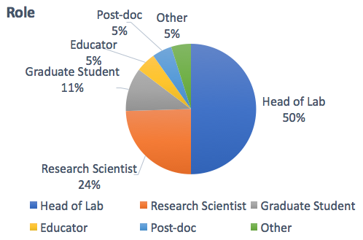
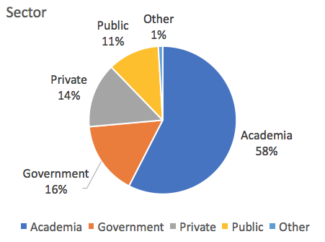
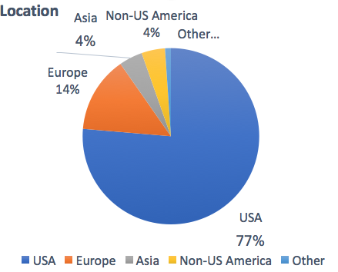
Demographics

Slide 20
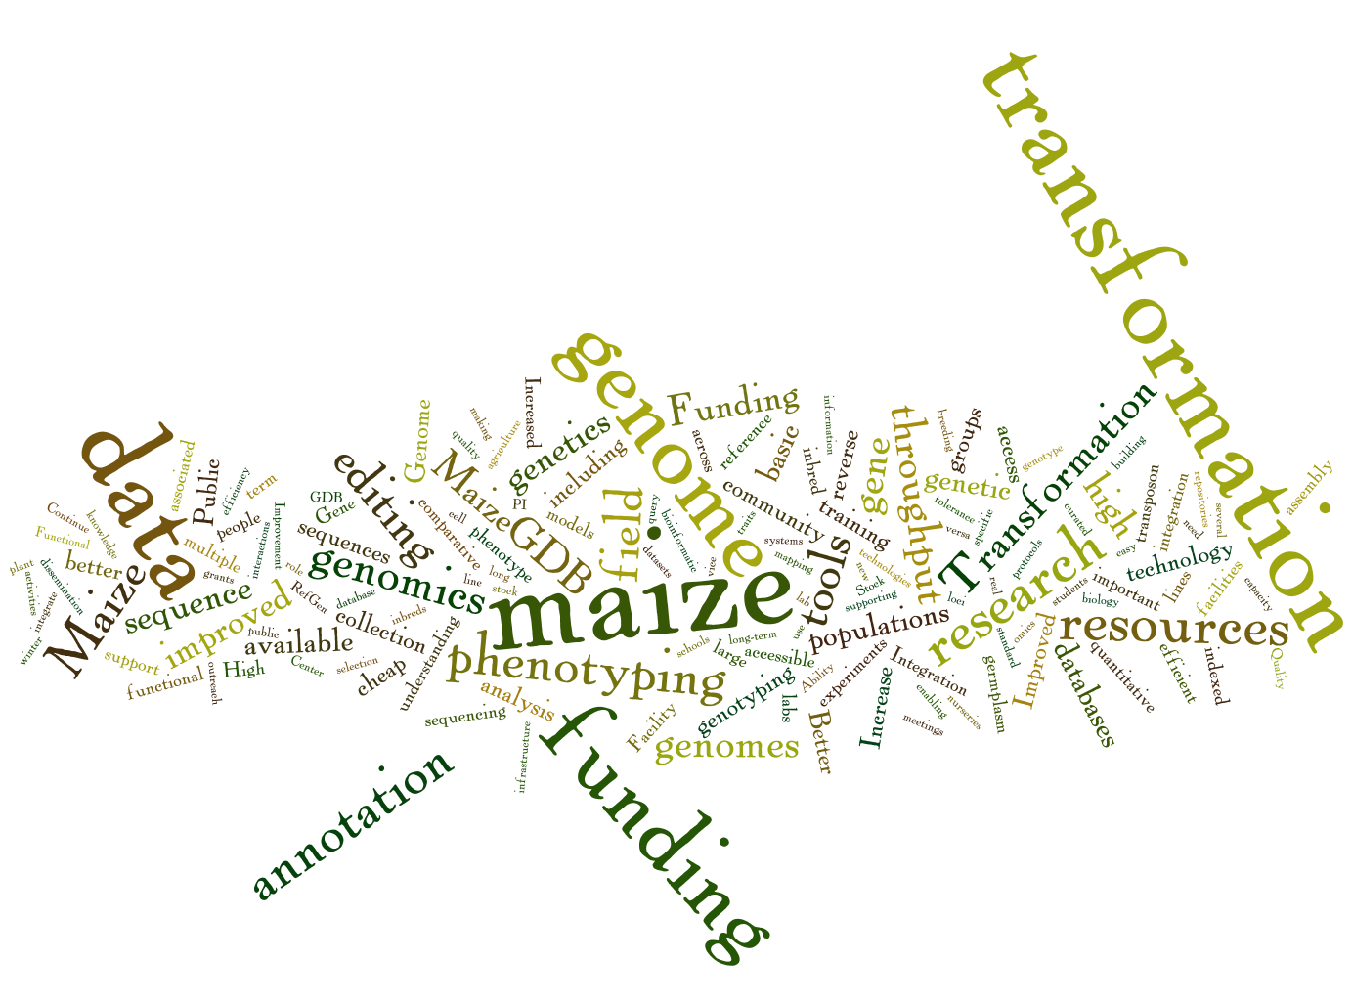
5-YEAR TIMEFRAME

Slide 21
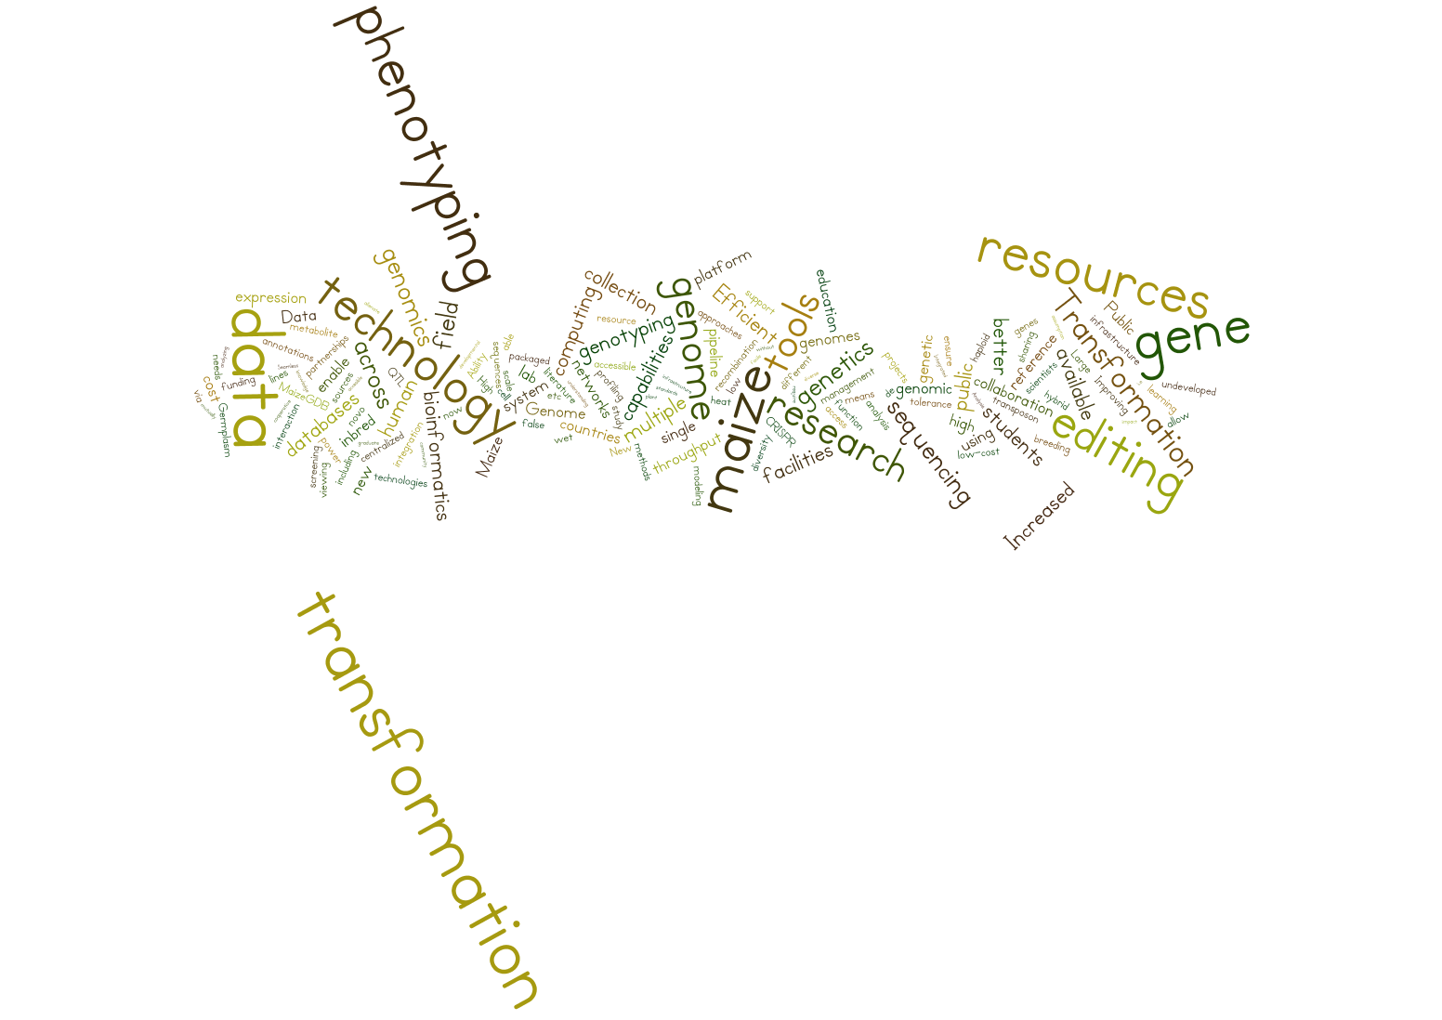
20-YEAR TIMEFRAME

Slide 23
Data
Near-Term
Long-Term
Pan-Genome |  | 25
Quality Annotation |  | 8
Database Ease of Use |  | 5
Modelling |  | 4
Bioinformatic Tools |  | 3
Gene Expression Databases |  | 3
Phenotype Data Management |  | 3
Epigenome |  | 2
Integrated Databases |  | 2
Pan-Genome |  | 10
Integration of Data Sources |  | 3
Simplified and Integrated Analysis |  | 3
Computing Power |  | 2
Databases |  | 2
Phenotype Data |  | 2
Pan-Genome Themes: More high-quality genomes; Immediate need for tools to access and use pan-genome

Slide 24
Functional Genetics Tools
Near-Term
Long-Term
Transformation/Gene-Editing |  | 42
Sequence-indexed Collections |  | 5
Regulated Trial Support - WN |  | 1
TILLING |  | 1
Transformation/Gene-Editing |  | 35
Sequence-Indexed Collections |  | 4
Dominant Mutations |  | 1

Slide 25
Public Resources
Maize GDB |  | 10
Maize Stock Center |  | 6
Ames PI Station |  | 4
Coordinate GeneBanks |  | 1
Germplasm Enhancement of Maize |  | 1
In situ Conservation |  | 1
Mapping Populations |  | 1
Winter and Summer Nurseries |  | 1

Slide 26
Other Themes Mentioned in Various Ways
Phenotyping
  Access to facilities; Data standardization, management, and integration
Genotyping
  Access to public facility
Lab to Product / Public-Private Partnership
Funding
  Pilot Funding; Individual vs Large-project
  “Cheaper, more-efficient…” everything
Advocacy
International Collaboration and Infrastructure
Recruiting and Educating New Scientists – Especially in long-term responses

Slide 27
Priority Inbreds

Slide 28
Priority Inbreds
Inbred | Responses | Release Date
B73 | 39 | 1972
W22 | 29 | 1948
Mo17 | 28 | 1973
B104 | 10 | 1997
A619 | 7 | 1961
A188 | 5 | 1945
PH207 | 5 | 1982
Oh43 | 4 | 1959
W64A | 3 | 1953
W23 | 3 | 1938
A632 | 3 | 1976
Gaspe' Flint | 2
High-quality Genome Assembly | 2.42
Integrated into Public Browser | 2.91
Gene Expression Atlas | 2.98
Transformation and Gene-Editing Capability | 3.01
Seed Available from Defined Source | 3.33
Transposon or Other Mutant Resource | 3.4
Detailed Phenotype Profile | 3.56
Seed Available - Do Not Need to Increase | 3.58
DH, RIL, or MAGIC Mapping Populations | 3.62
Proteome Atlas | 3.66
Performance Data Across Diverse Environments | 3.69
No IP Restrictions | 2.83
Broadly Adapted | 3.08
Unique Characteristics for My Research | 3.39
Easy to Grow | 3.39
Relevant to Global Temperate Seed Industry | 3.48
Relevant to U.S. Seed Industry | 3.62
Historical Importance | 3.65
Relevant to Global Tropical Seed Industry | 3.88
Average Release Date: 1964
Notes:
Average maize yield in 1964 was 62.9 bu/A

Slide 29
IBM Population
B73 Reference NAM
B73 Genome Pub
RFLP - Heterosis
B73 Gene Atlas
Transgenic Maize

Slide 30
Discussion of Priority Community Inbreds
Distinct choices allow the community to leverage and integrate data
Lab to Product and Commercial Relevance mentioned in survey
  Supports role for recent inbreds including ex-PVPs
Pan-Genome characterization prominent in survey
  Diversity characterization
  Tools to use diversity for discovery

Slide 31
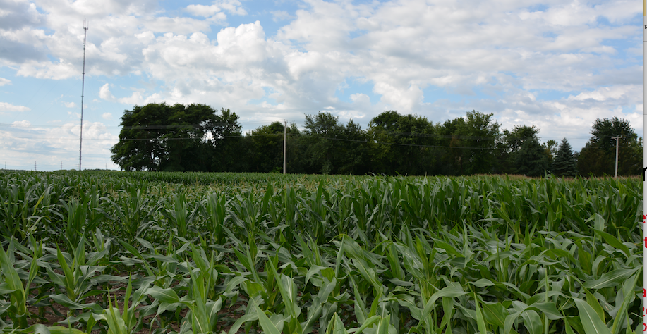
Discussion of Survey or Other Topics?

